Slide 1
— Senior Design —
Online Processing for Molten Salt Reactors
David Barnett, davidbb2
Nathan Glaser, nglaser3
Joseph Specht, jspecht3

Slide 2
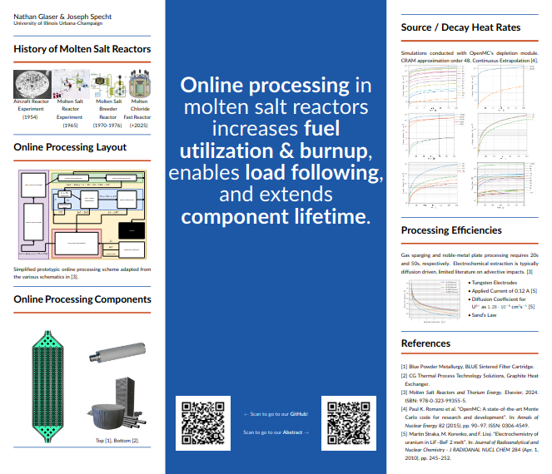

Student Conference

Slide 3
Background

Slide 4
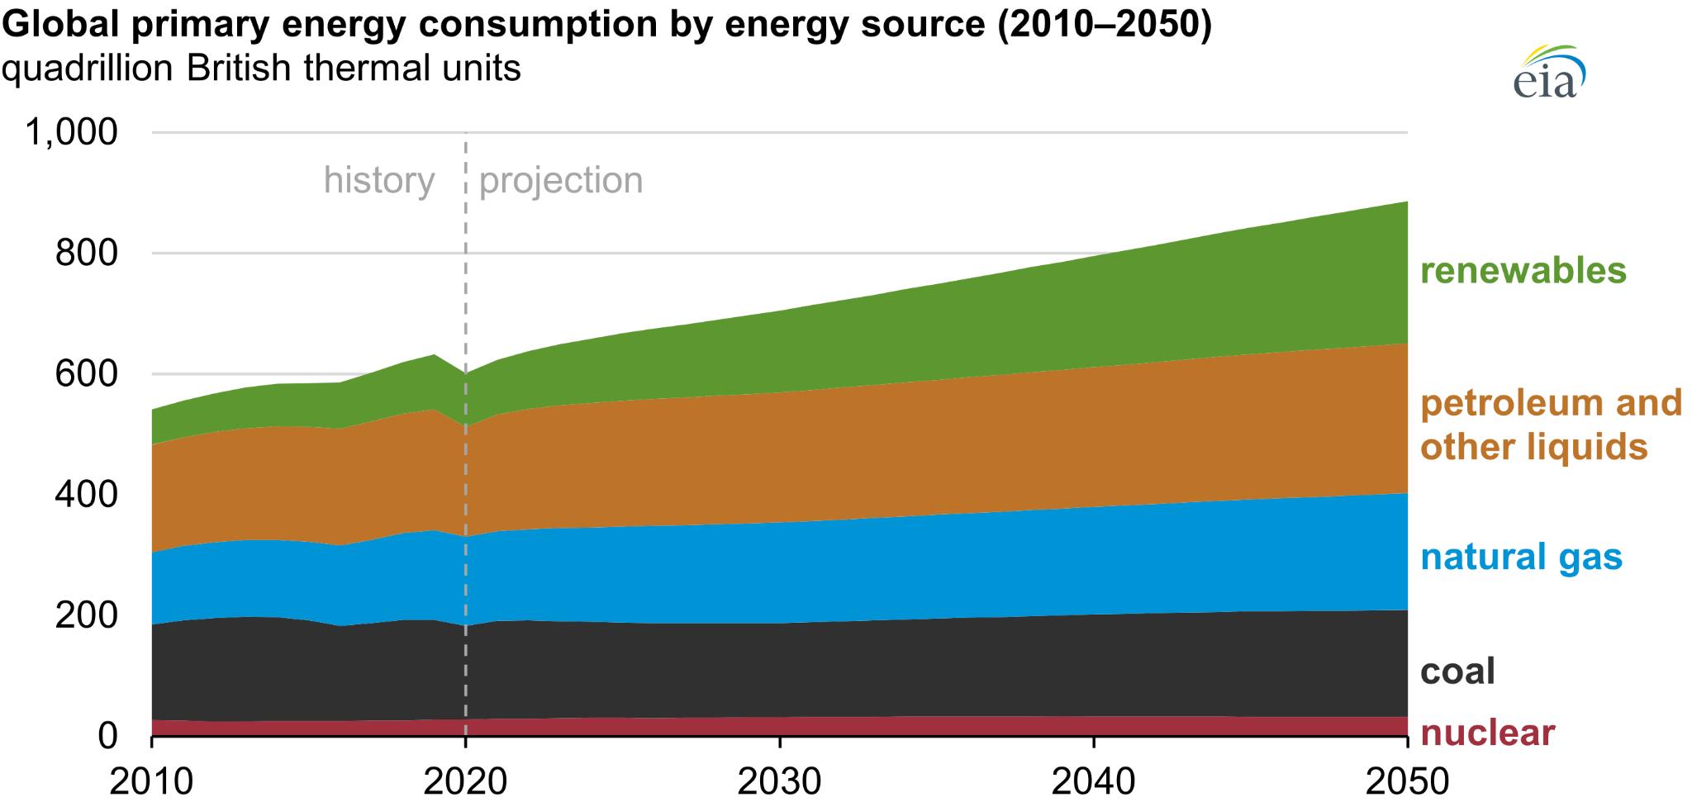
Future of Nuclear
Rapid growth in energy demand in the near future
Nuclear will play a big role
High power density
>90% capacity factor
U.S. Energy Information Administration, International Energy Outlook 2021 Reference case [1]
Notes:
David

Slide 5
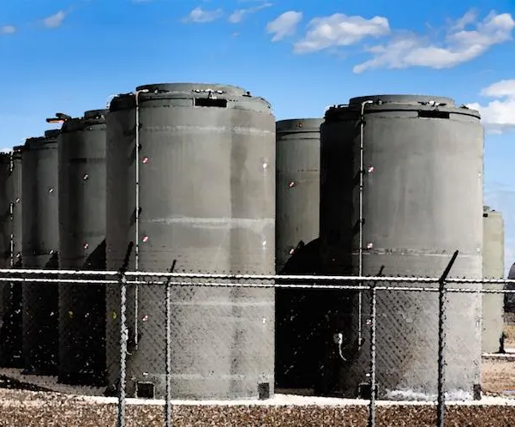



Nuclear Problems
Waste
Politics
Economics
Safety
Dry cask storage [2]
Nuclear Energy by Henry Moore [4]
Symbol of USD [3]
Nuclear Inspector [5]
Notes:
David

Slide 6
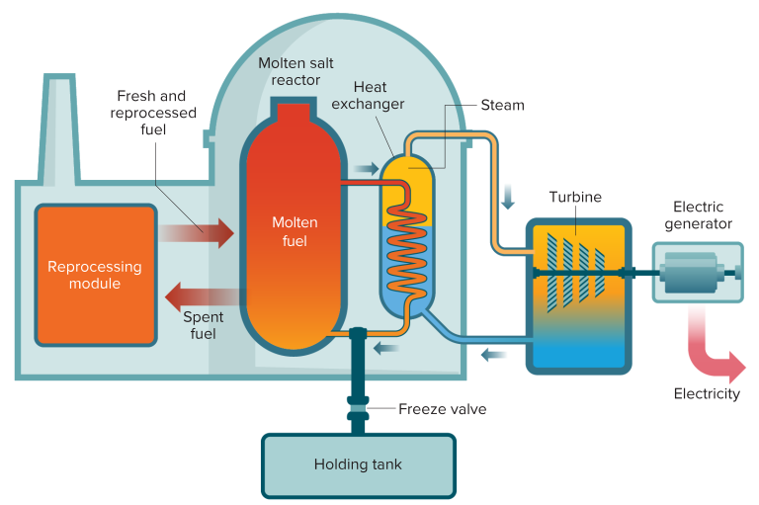
Molten Salt Reactors (MSRs)
Gen IV advanced reactor [6]
Salt-cooled
Salt is the coolant
Liquid-Fueled
Salt is still the coolant
Fuel also dissolved in salt
How a molten salt reactor works [7]
Notes:
David

Slide 7
Advantages of MSRs
Disadvantages of MSRs
Easy fuel processing
Breeding
Diverse fuel cycles
Th-U, U-Pu, UNF
Burns TRansUranic waste (TRU)
Load following
Fission product advection
Tritium production (91 grams / year)
Noble metal plate-out
Fuel-salt corrosivity
Outlet Temperatures
Physical limit for rankine cycles
Fission gas & uranium removal
Notes:
David

Slide 8
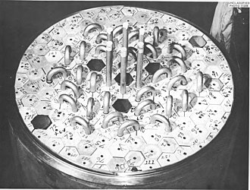
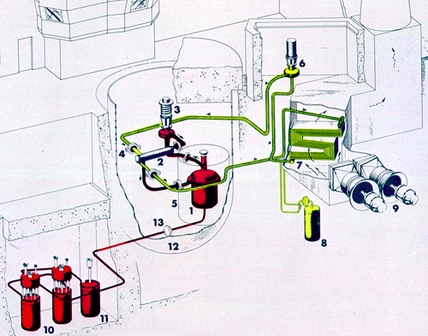
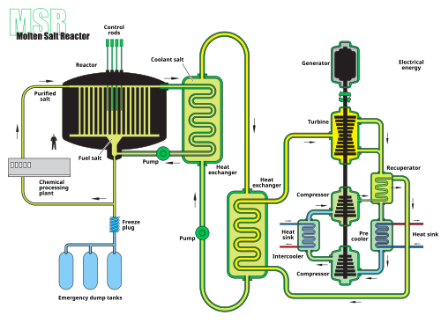
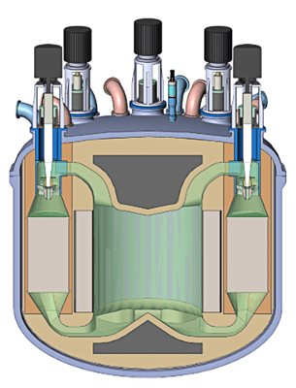
History of MSRs
Aircraft Reactor Experiment
(1954) [8]
Molten Salt Reactor Experiment (1965) [9]
Molten Salt Breeder Reactor (1970-1976) [10]
Molten Chloride Fast Reactor
(+2025) [11]
Notes:
Joe

Slide 9
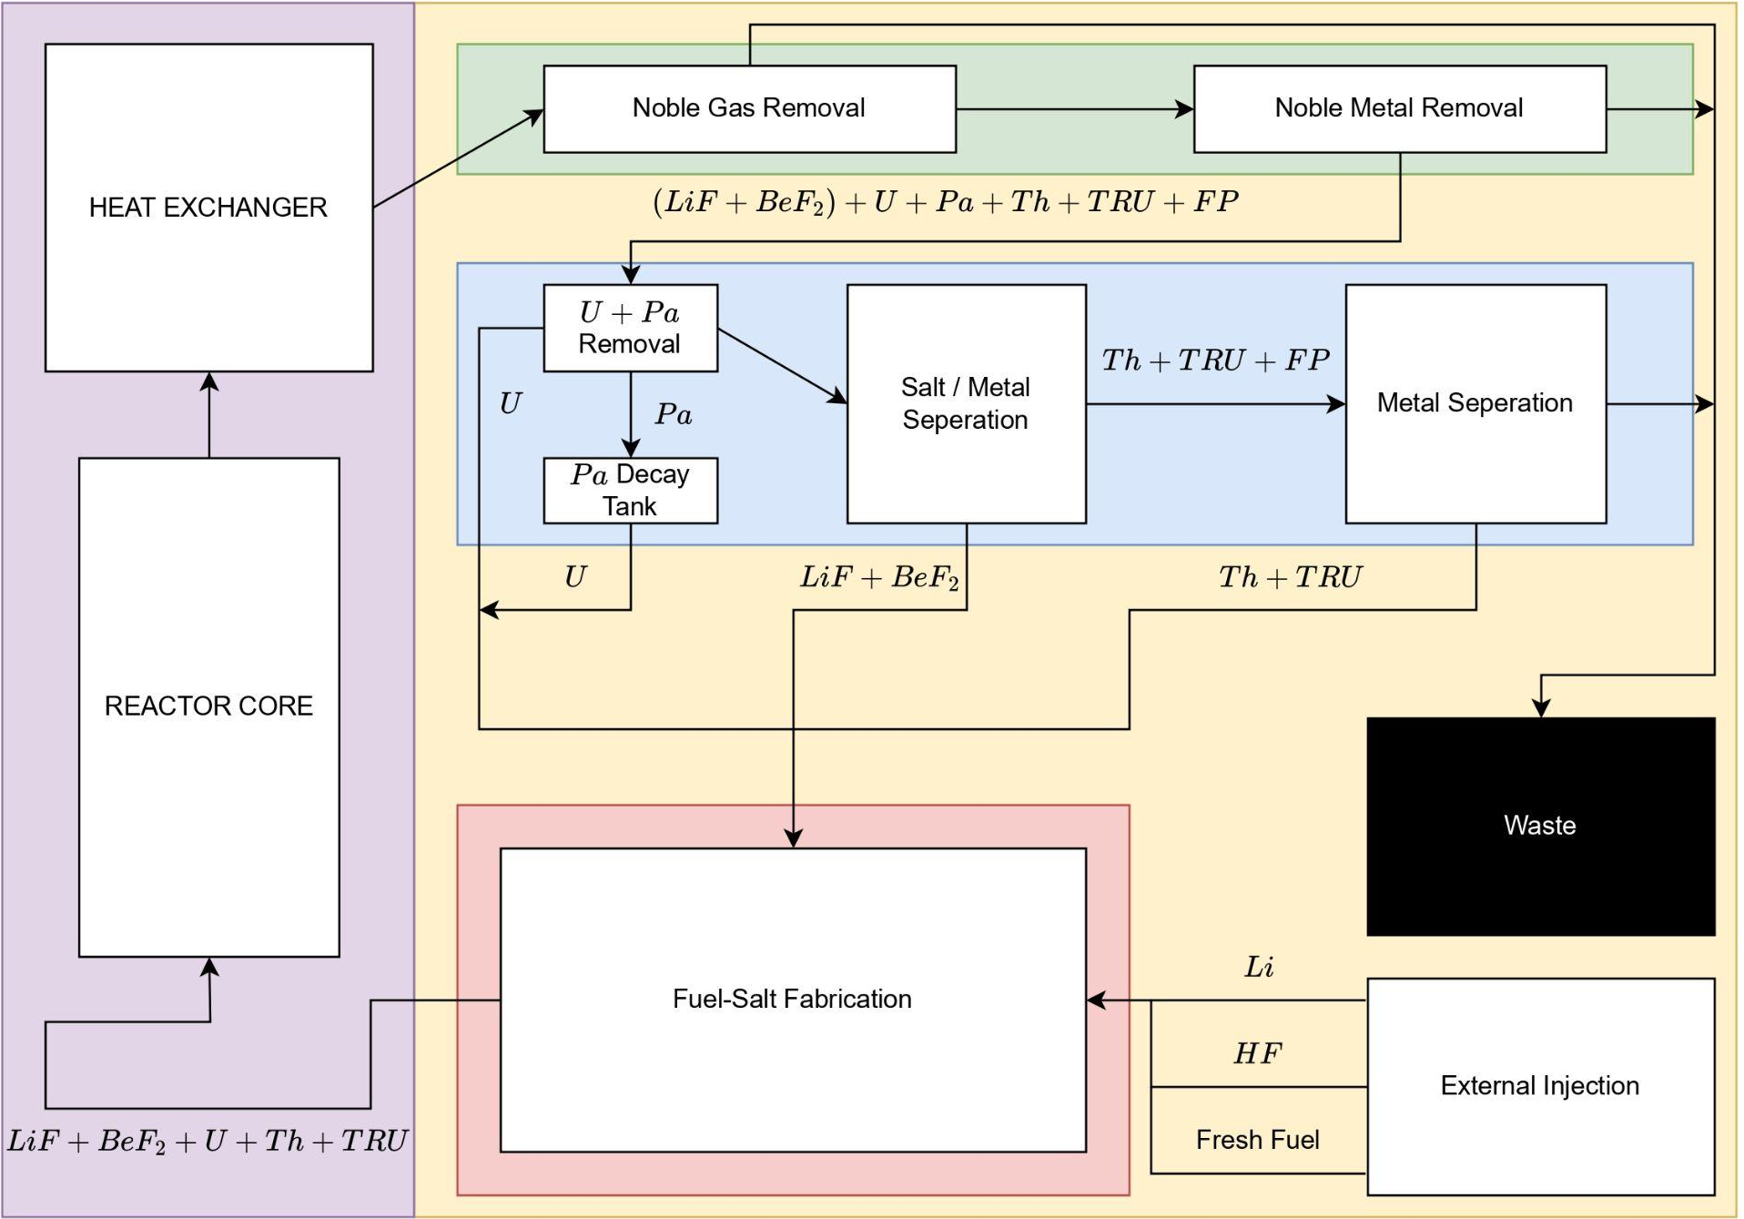
Processing Methods
Offline (batch-wise) processing
portion of fuel-salt
product concentration limited by portion diverted
standard due to technical limitations
Online (continuous) processing
entire fuel-salt inventory
no limit on product concentration
higher breeding ratio
higher ΔP load-following
Main fuel-salt line
Portion of fuel-salt
Isolated
processing module
Simplified offline processing scheme
Simplified online processing scheme
Notes:
Nathan

Slide 10
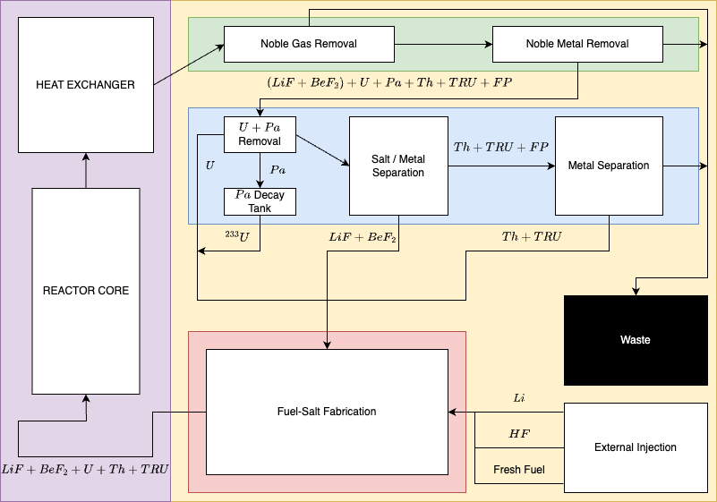
Online (Continuous) Processing
Notes:
Nathan

Slide 11
+++ Maximize +++
--- Minimize ---
Thermal efficiency
Fuel utilization / breeding ratio
Component lifetime
Displacement Per Atom (DPA)
Heat eXchanger (HX) plate-out
Corrosion
Worker Dosage
Total fuel-salt inventory
Concentrations of fission products deleterious to performance
Proliferation risk during processing
Notes:
Nathan

Slide 12
Project Overview

Slide 13
Table of Contents
Products of Interest
Removal Methods
Secondary Side
Cost Analysis
Conclusions

Slide 14
Products of Interest

Slide 15
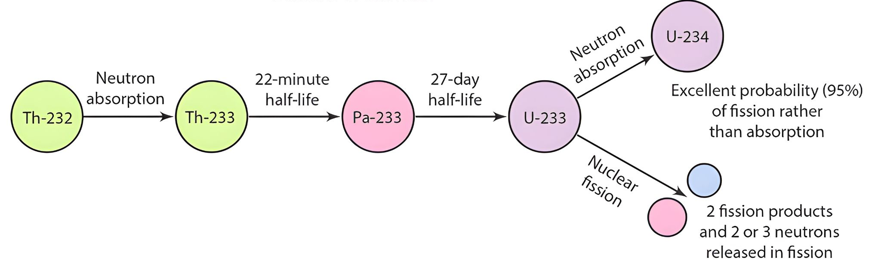
Breeding Chain Isotopes
Overview of Th-232 to U-233 conversion [12]
Notes:
Joe

Slide 16

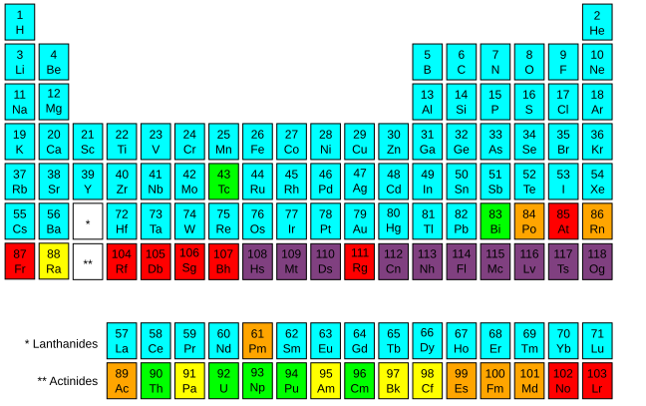
Transuranics
Lanthanides
Highly radioactive
Undesirable in waste
Burn away in fuel-salt
Parasitic absorbers that are not…
fissile, fissionable, or fertile
Transuranic elements [13]
Lanthanide elements [13]
Notes:
Joe

Slide 17
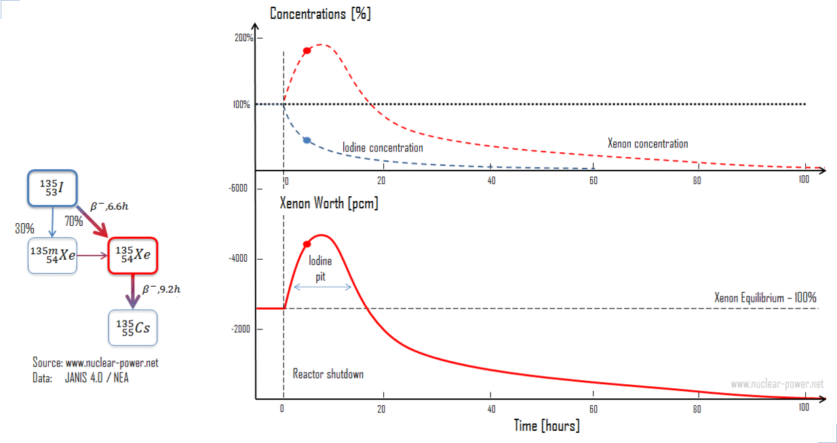
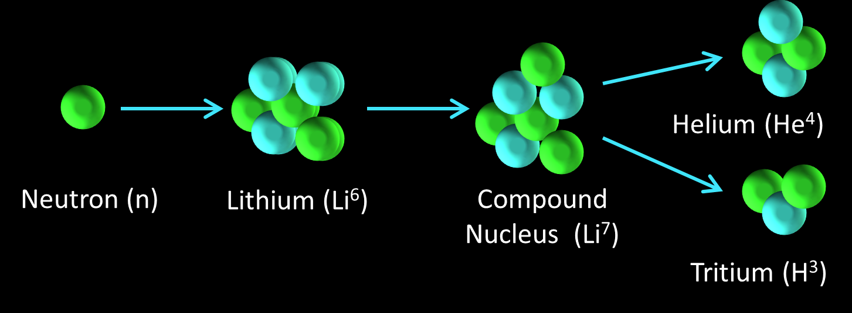
Fission Gasses
Tritium
Xenon transient isotopes
I-135 → Xe-135
Krypton
Produced from Li-6 fission
Highly permeable in metals
embrittles metallic components
Significant contribution to dosage
Xenon Response to reactor power changes [14]
Lithium-neutron fission reaction [15]
Notes:
Joe

Slide 18
Removal Methods

Slide 19
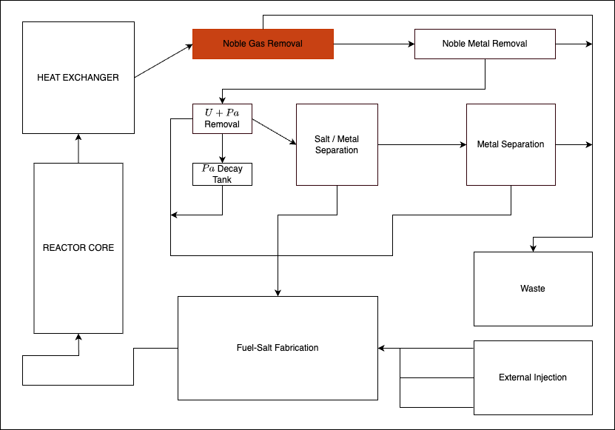
Gas Sparging and Separating
Notes:
Nathan

Slide 20
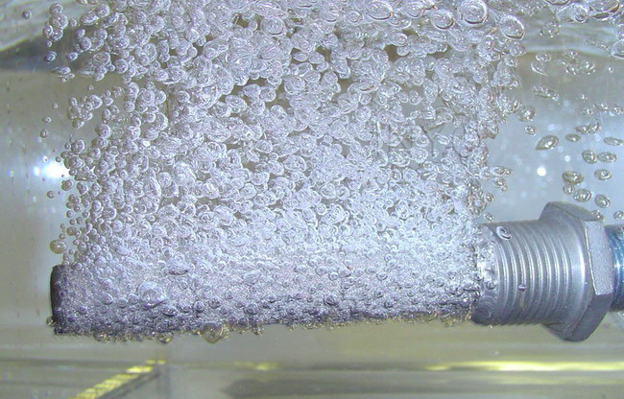
Gas Sparging and Separating
Sparge inert gas into fuel-salt
99.9% of fission gasses diffuse in ~20 seconds
Centrifuge to separate gas from fuel-salt
Filter solids from off-gas
Scrub fission gasses with
charcoal beds
Recycle inert gas
Gas sparger in water [16]
Notes:
Nathan

Slide 21
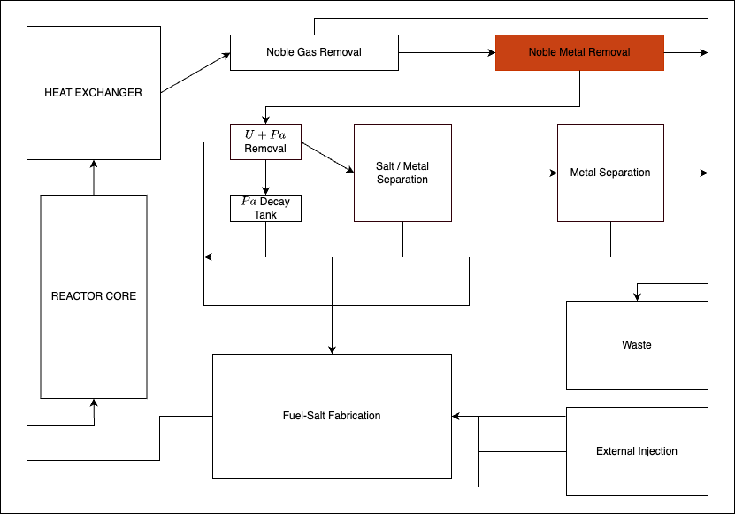
Metallic Filter
Notes:
Nathan

Slide 22

Metallic Filter
Noble metals selectively plate-out on metallic surfaces
Specifically, nickel is chosen for…
affinity for noble metal plate-out,
high corrosion resistance,
low cost
High surface area “sponge”
sacrificial plate-out surface
Aquarium filter as reference shape [17]
Notes:
Nathan

Slide 23
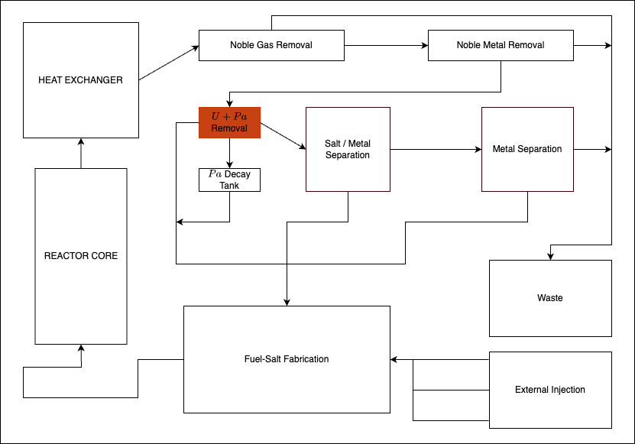
Electrochemical Module with FLiBe
Notes:
Nathan

Slide 24

Electrochemical Module with FLiBe
Tungsten Anodes from [18]
Notes:
Nathan

Slide 25
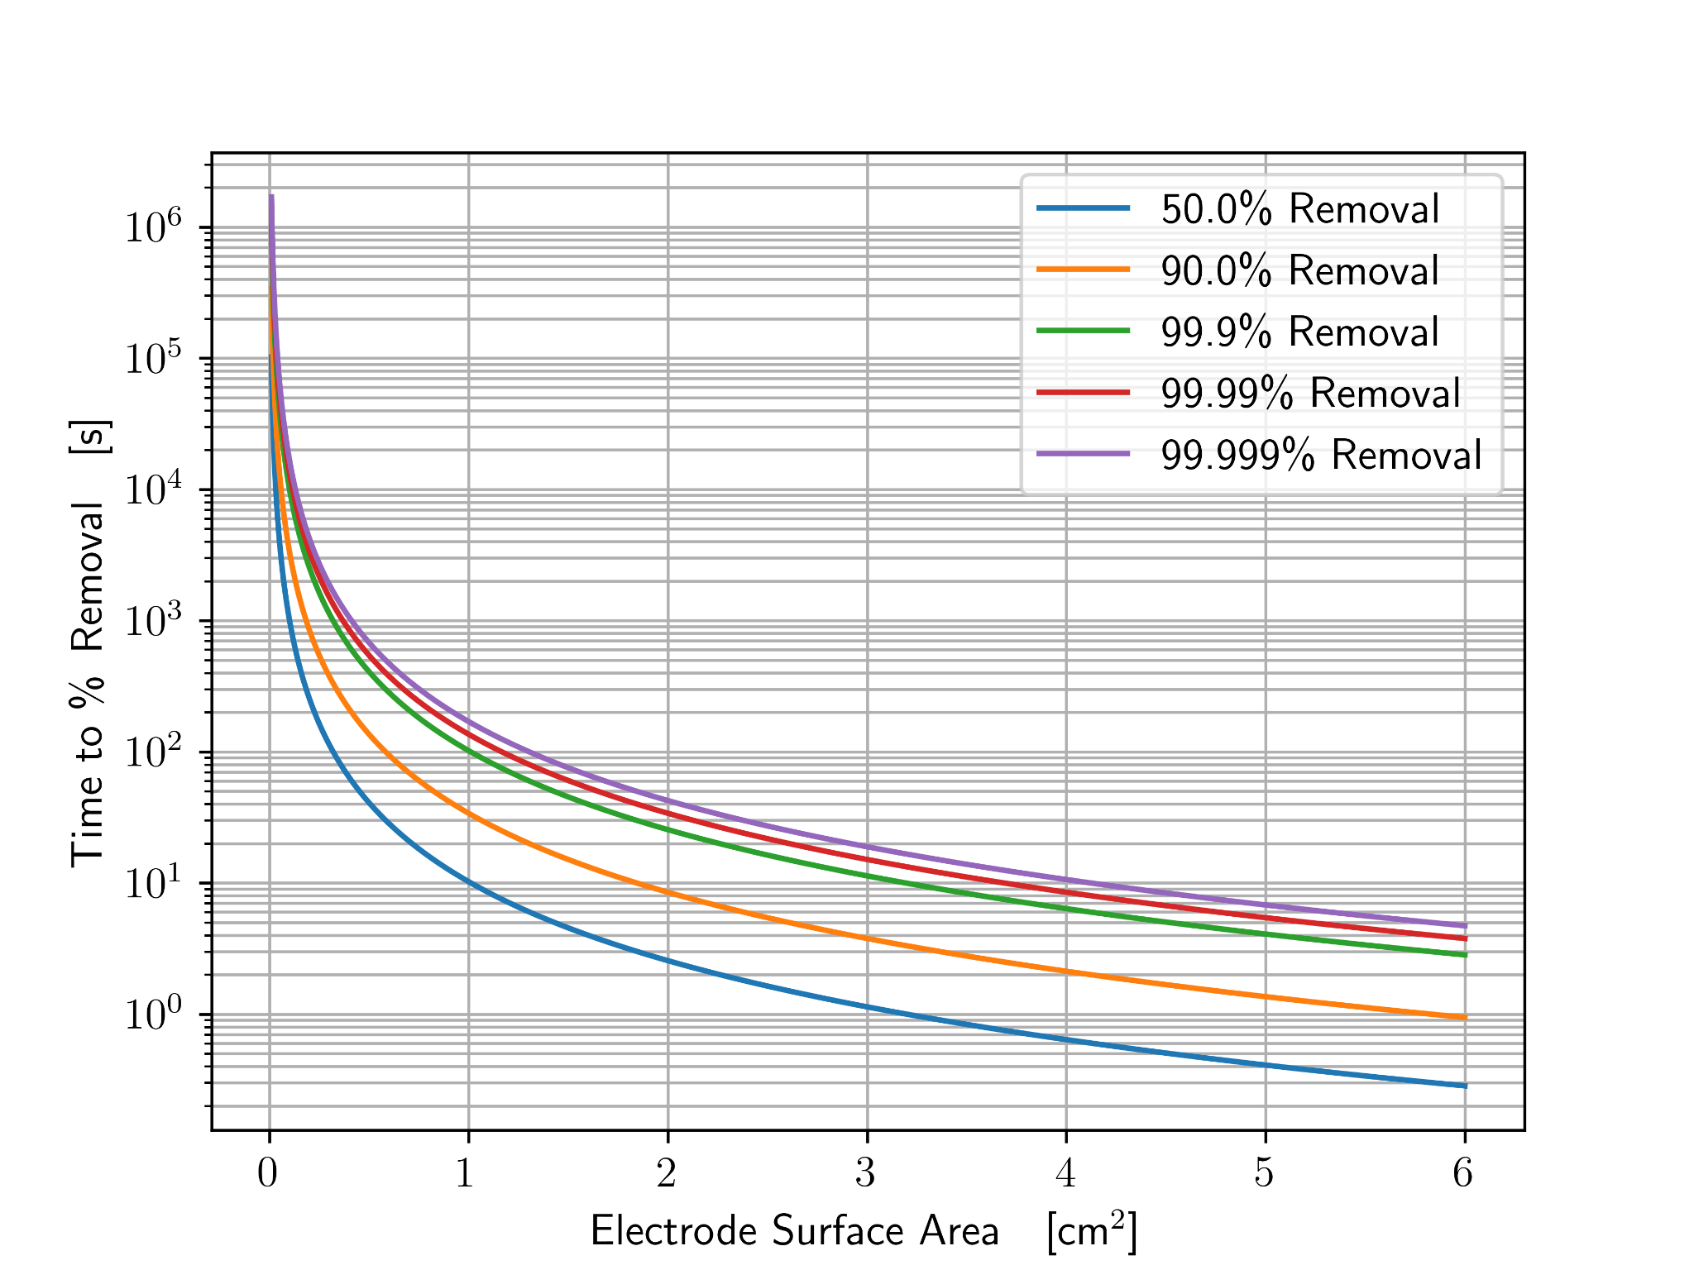
Electrochemical Module with FLiBe
Tungsten electrodes
Remove U without BeF dissolution
Higher efficiency than FSV (99.999%>95%)
Assuming diffusion based mixing
42.7s timescale
7182.8 Reynolds -> Turbulent mixing
Channel Params | Channel Count | Length | Width | Electrode Count | Effective Flow Area | Linear Velocity
Values | 5 | 8.86 m | 0.69 m | 2480 | 0.97 m² | 0.21 m/s
Notes:
Nathan

Slide 26

Graphite Separators
91 grams of tritium per year
Hydrogen storage capacity in graphite of 4.48 wt% [19]
Required thickness of graphite of 5.9e-3 cm to store all tritium
Choose 1 cm thickness
Any commercial thickness suffices
Double walled
Graphite separators between each channel
Notes:
Joe

Slide 27
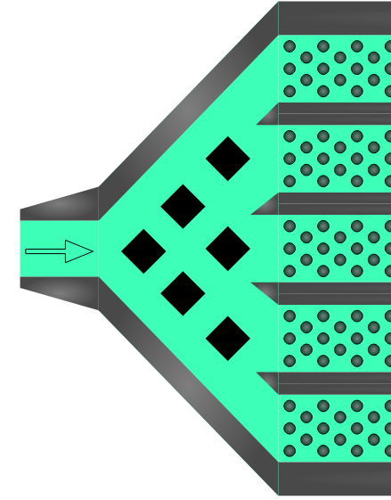
Channel Shutdown
Electrochemical Processing Modules
4 per reactor, 1 for each leg
5 channels per EPM
Graphite pylons to shut down and drain each channel
go from 5 → 4 channels
flow depth from
150 cm → 180 cm
Online operation
Graphite channel blockers
Notes:
Joe

Slide 28
Secondary Side

Slide 29
Thermal Cycle
Convert from Rankine to sCO₂ Brayton cycle
Better suited to MSBR temperature range
Lower pressure and higher thermal efficiency
Fluid | Cycle | η | Pressure [atm] | Temp Range [°C]
Water | Rankine | 43.4%* | 250 | <550
sCO2 | Brayton | >50% | 200 | 550-850
He | Brayton | 54% | 80 | >850
Notes:
Joe

Slide 30
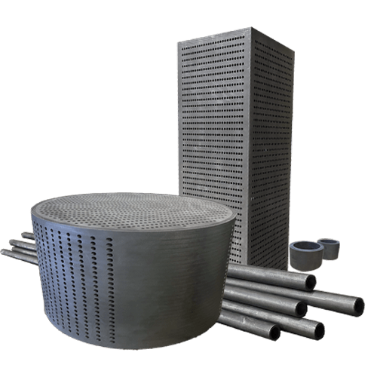
Graphite Heat Exchanger
40% of noble metal plates-out in MSBR heat exchanger
Problematic in sLOFA
kW of decay heat being produced
Metallic HX → Graphite HX
Decreases noble metal plate out
SiC buffers decreases tritium released to secondary loop
Graphite heat exchanger from CG Thermal [20]
Notes:
Joe

Slide 31
Cost Analysis

Slide 32
Economics
7 year lifespan
Estimate a 3% downtime
1000 MWe
$1.7 billion estimated for set up. includes siting, weather monitoring, construction, redundancy
$3,225,000 for electrodes
$600,000 for autonomous hot cells
$3,000,000 for actual module
$350,000,000 decom fund
$10,000,000 per year fuel cost
8.25% tax
$38.80 per MW/h
Notes:
David

Slide 33
Conclusions

Slide 34
Future Work
Investigate secondary side further
Rankine to sCO₂ Brayton cycle
graphite heat exchanger
Sell additional products
medical isotopes
actinides and lanthanides
Pulsing of electrodes
Notes:
David

Slide 35
Questions?

Slide 36
Presentation References
[1] https://www.eia.gov/todayinenergy/detail.php?id=49876
[2] https://www.forbes.com/sites/jamesconca/2020/03/18/nuclear-regulatory-commission-shows-dry-cask-storage-is-safe--yet-again/
[3] https://www.presentermedia.com/powerpoint-clipart/money-symbol-pc-pid-4970
[4] https://en.wikipedia.org/wiki/Nuclear_Energy_%28sculpture%29
[5] https://www.wano.info/the-vital-focus-on-ever-improving-nuclear-safety/
[6] U.S.D. of Energy. Pathways to Commercial Liftoff: Advanced Nuclear. Tech. rep. Department of Energy, 2024.
[7] https://knowablemagazine.org/content/article/technology/2019/nuclear-goes-retro-much-greener-outlook
[8] https://en.wikipedia.org/wiki/Aircraft_Reactor_Experiment
[9] https://en.wikipedia.org/wiki/Molten-Salt_Reactor_Experiment
[10] https://en.wikipedia.org/wiki/Molten-salt_reactor
[11] https://www.nrc.gov/reactors/new-reactors/advanced/who-were-working-with/pre-application-activities/mcfr.html
[12] https://www.researchgate.net/figure/Overview-of-232-Th-to-233-U-conversion-taken-from-18_fig2_326332052
[13] https://en.m.wikipedia.org/wiki/File:Periodic_Table_Radioactivity.svg
[14] https://www.nuclear-power.com/nuclear-power/reactor-physics/reactor-operation/xenon-135/xenon-transients/
[15] https://news.newenergytimes.net/2022/01/08/lithium-lithium-everywhere-and-none-to-use-for-fusion-reactors/
[16] https://www.inyoprocess.com/gas-sparger.html
[17] https://www.rinkerpipe.com/blog/how-to-choose-the-right-pipe-shape-for-your-project/
[18] https://www.elmettechnologies.com/product/125-x-72-tungsten-rod-ground/?gQT=1
[19] Mohan M, Sharma VK, Kumar EA, Gayathri V. Hydrogen storage in carbon materials—A review. Energy Storage. 2019; 1:e35. https://doi.org/10.1002/est2.35
[20] https://cgthermal.com/blog/material-and-design-upgrades-to-graphite-heat-exchangers/

Slide 37
Report References
[1] U. S. D. of Energy. Pathways to Commercial Liftoff: Advanced Nuclear. Tech. rep. Department
of Energy, 2024.
[2] A. P. P. Association. “America’s Electricity Generating Capacity”. In: (2024).
[3] W. N. Association. “Nuclear Power Reactors”. In: (2025).
[4] GIF R&D OUTLOOK FOR GENERATION IV NUCLEAR ENERGY SYSTEMS. Tech. rep.
Generation IV International Forum, 2018. url: https : / / www . gen - 4 . org / resources /
reports/gif- research- and- development- outlook- generation- iv- nuclear- energy-
systems-2018.
[5] H. Li et al. “Study on tritium transport characteristics in fluoride-salt-cooled high-temperature
advanced reactor”. In: International Journal of Hydrogen Energy 56 (2024), pp. 1101–1110.
issn: 0360-3199. doi: https://doi.org/10.1016/j.ijhydene.2023.12.199. url: https:
//www.sciencedirect.com/science/article/pii/S0360319923064996.
[6] P. N. Haubenreich and J. R. Engel. “Experience with the Molten-Salt Reactor Experiment”.
In: Nuclear Applications and Technology 8.2 (1970), pp. 118–136. doi: 10.13182/NT8-2-118.
eprint: https://doi.org/10.13182/NT8-2-118. url: https://doi.org/10.13182/NT8-2-
118.
[7] R. C. Robertson. CONCEPTUAL DESIGN STUDY OF A SINGLE-FLUID MOLTEN-SALT
BREEDER REACTOR. Tech. rep. comp.; Oak Ridge National Lab. (ORNL), Oak Ridge, TN
(United States), Jan. 1971. doi: 10.2172/4030941. url: https://www.osti.gov/biblio/
4030941.
18
[8] Molten Salt Reactors and Thorium Energy. en. Elsevier, 2024. isbn: 9780323993555. doi:
10.1016/C2021- 0- 01689- 8. url: https://linkinghub.elsevier.com/retrieve/pii/
C20210016898 (visited on 03/22/2025).
[9] Advanced Nuclear. en-US. url: https : / / liftoff . energy . gov / advanced - nuclear - 2/
(visited on 03/22/2025).
[10] U. A. E. C. D. of Reactor Development and Technology. AN EVALUATION OF THE MOLTEN
SALT BREEDER REACTOR. Tech. rep. US ATOMIC ENERGY COMISSION, 1972.
[11] V. Dostál. “A supercritical carbon dioxide cycle for next generation nuclear reactors /”. In:
154 (June 2005).
[12] C. W. Forsberg et al. “Tritium Control and Capture in Salt-Cooled Fission and Fusion
Reactors: Status, Challenges, and Path Forward”. In: Nuclear Technology 197.2 (2017), pp. 119–139.
doi: 10.13182/NT16-101. url: https://doi.org/10.13182/NT16-101.
[13] M. C. Cannon et al. “Adsorption of Xenon and Argon on Graphite”. In: Nuclear Science and
Engineering 12.1 (1962), pp. 4–9. doi: 10.13182/NSE62-A25362.
[14] V. Ignatiev et al. “Intergranular tellurium cracking of nickel-based alloys in molten Li, Be,
Th, U/F salt mixture”. In: Journal of Nuclear Materials 440.1 (2013), pp. 243–249. issn:
0022-3115. doi: https : / / doi . org / 10 . 1016 / j . jnucmat . 2013 . 05 . 001. url: https :
//www.sciencedirect.com/science/article/pii/S0022311513007071.
[15] B. Gurovich et al. “Fractographic studies and tensile strength of MPG-6 graphite based on
uncalcined coke, neutron-irradiated at a high temperature”. In: Nuclear Materials and Energy
35 (2023), p. 101453. issn: 2352-1791. doi: https://doi.org/10.1016/j.nme.2023.101453.
url: https://www.sciencedirect.com/science/article/pii/S2352179123000923.
[16] B. J. Riley et al. “Molten salt reactor waste and effluent management strategies: A review”.
In: Nuclear Engineering and Design 345 (2019), pp. 94–109. issn: 0029-5493. doi: https:
//doi.org/10.1016/j.nucengdes.2019.02.002. url: https://www.sciencedirect.com/
science/article/pii/S002954931930024X.
[17] IAEA. Non-baseload Operation in Nuclear Power Plants: Load Following and Frequency Control
Modes of Flexible Operation. Tech. rep. IAEA, 2018.

Slide 38
Backup Slides

Slide 39

Electrochemical Module with FLiBe
Tungsten electrodes
Remove U without BeF dissolution
Higher efficiency than FSV (99%>95%)
1.88m, .375cm
Assuming diffusion driven mixing, Sand’s law for time to efficiency
42.7s
VERY conservative assumption
Pipe flow speed of 7.8 m/s yields length of 330m
Not feasible to fit into containment, need to slow down
Diverge flow to decrease linear velocity

Slide 40
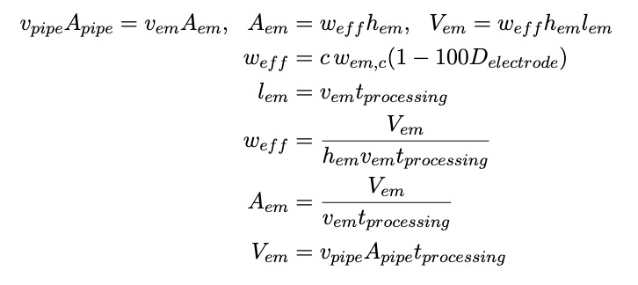
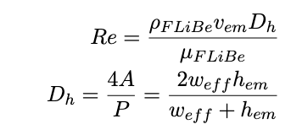
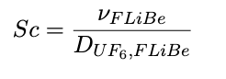
Volume of electrochemical module (em) is known
43.1 m3 fuel-salt
117.4 m3 combined total channel volume
Minimizing the module length and width yields:
channel flow width of 0.65 m
channel length of 8.86 m
channel velocity of .2 m/s
Reynolds number of 7182 -> turbulent flow so mixing is advection driven
779680 electrodes ($118M)
Schmidt number for relation of advective to diffusive mass transport -> 204513.92
Electrochemical Module with FLiBe

Slide 41
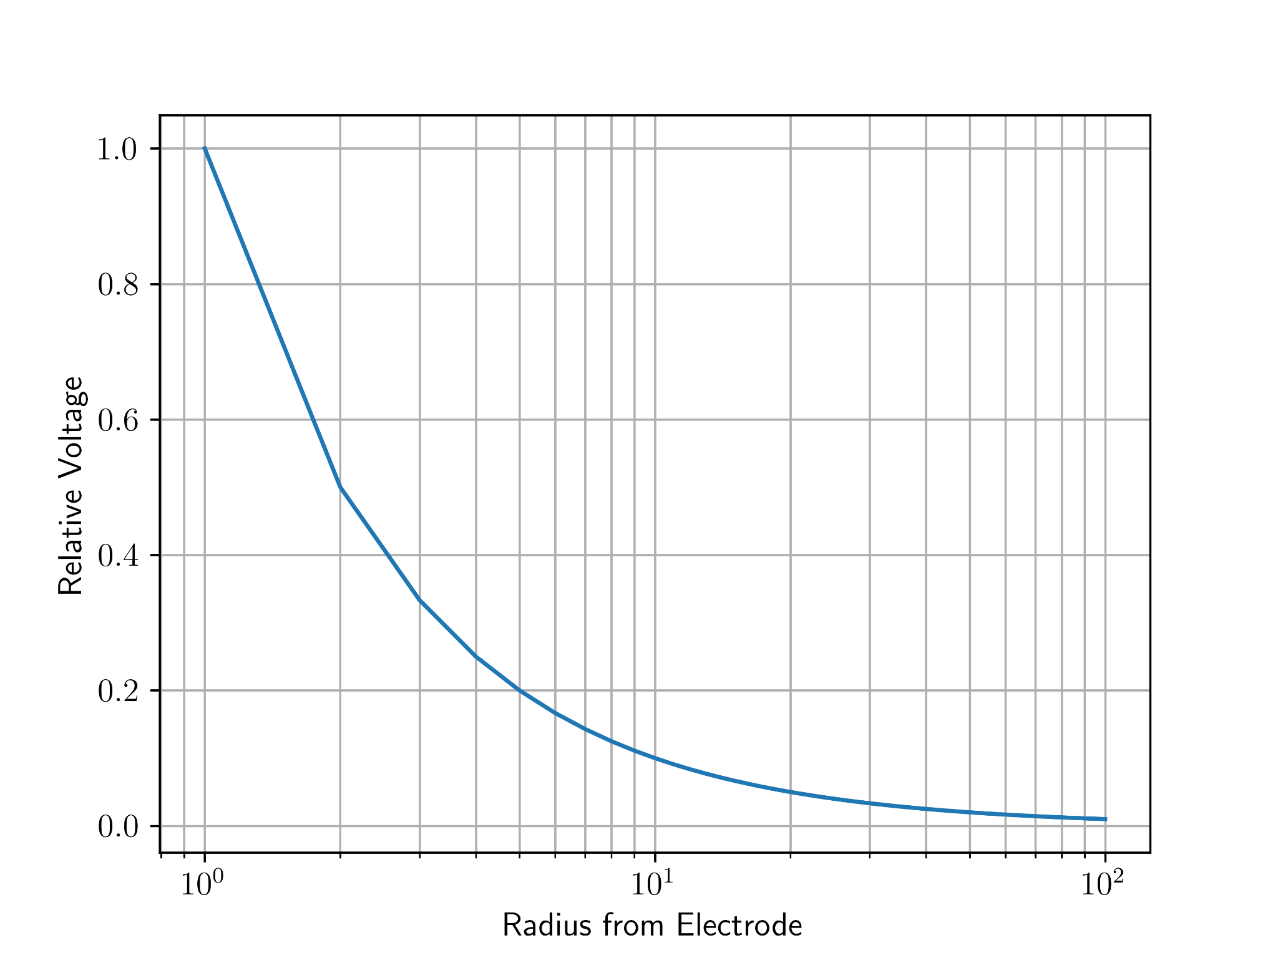
Electrochemical Module with FLiBe
Number of electrodes per meter
Was based on diffusion, now electrical resistivity of FLiBe (20% -> 10 /m)
Redid calculations changing 100 to 10, keeping channel flow width and length
3.43 m combined total channel width
45.6 m3 combined total channel volume
2640 electrodes ($0.401M)
Reynolds number did not change

Slide 42
Graphite Calculations
Tritium production
2.89 𝜇g per second
91 grams per year
Graphite has a hydrogen storage capacity of 4.48 wt% [XXX]
91 g / 4.48% = 2.031 kg of graphite per year
for 7 year life-time, need 28.438 kg of graphite
/ 16 channels / 2.26e-3 kg/cm³
/ 886 cm / 150 cm
Required thickness of graphite of 5.9e-3 cm
Plate of any commercial thickness will be sufficient
Double walled

